Slide 1
Unit 13 Transformations

Slide 2
Notes on Symmetry

Slide 3
Line Symmetry
A figure in the plane has line symmetry if the figure can be mapped onto itself by a reflection in a line.
The line of reflection is a line of symmetry.

Slide 4
Lines of Symmetry
How many lines of symmetry does the hexagon have?

Slide 5
Lines of Symmetry
How many lines of symmetry does the hexagon have?

Slide 6
Rotational Symmetry
A figure in a plane has rotational symmetry if the figure can be mapped onto itself by a rotation of 180º or less about the center of the figure.
This point is the center of symmetry. Note that the rotation can be either clockwise or counterclockwise.

Slide 7
Rotational Symmetry
The figure below has rotational symmetry.

Slide 8
Rotational Symmetry
Does the figure have rotational symmetry?

Slide 9
Rotational Symmetry
Do the following figures have rotational symmetry?

Slide 10
Reflection Notes

Slide 11
Transformation
A transformation moves or changes a figure in some way to produce a new figure called an image.

Slide 12
Isometry
An isometry is a transformation that creates a congruent image.
Types of isometries
Translations
Reflections
Rotations

Slide 13
Another name for the original figure is the preimage.
Another name for the new figure is the image.

Slide 14
Notation
Every point in the original figure, preimage, is denoted with a capital letter (Ex: P, Q, R), while every point in the image is denoted with a capital letter followed by an apostrophe (Ex: P’, Q’, R’)

Slide 15
Reflection
A transformation that uses a line like a mirror to reflect a figure. The mirror line is called the line of reflection.

Slide 16
Line of Reflection

Slide 17
Coordinate Rule for Reflections
If (a,b) is reflected over the y-axis, its image is the point (-a, b)
If (a,b) is reflected over the x-axis, its image is the point (a, -b)

Slide 18
Coordinate Rule for Reflections
If (a,b) is reflected over the line y = x, its image is the point (b, a)
If (a,b) is reflected over the line y = -x, its image is the point (-b, -a)

Slide 19
Coordinate Rule for Reflections
If the point (4, 7) was reflected over the line y = x, what would be its image?
If the point (2, -5) was reflected over the x-axis, what would be its image?
If the point (-3, 6) was reflected over the y-axis, what would be its image?
If the point (-8, -3) was reflected over the line y = -x, what would be its image?

Slide 20
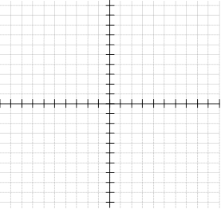
Examples

Slide 21
Rotations

Slide 22
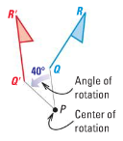
Rotations
A rotation is a transformation in which a figure is turned about a fixed point called the center of rotation.
Rays drawn from the center of rotation to a point and its
image form the
angle of rotation.

Slide 23
Coordinate Rules for Rotations about the Origin
When a point (a, b) is rotated counterclockwise about the origin:
For a rotation of 90º, (a, b)→(-b, a)
For a rotation of 180º, (a, b)→(-a, -b)
For a rotation of 270º, (a, b)→(b, -a)

Slide 24
Coordinate Rules for Rotations about the Origin
Remember…
90º counterclockwise = 270º clockwise
180º is the same from either direction
270º counterclockwise = 90º clockwise
If counterclockwise/clockwise is not stated, assume it is counterclockwise.

Slide 25
Rotations
Trapezoid has vertices E(-3, 2), F(-3, 4), G(1, 4) and H(2, 2). Find the vertices of the image for a 180º rotation about the origin.

Slide 26
Rotations
Trapezoid has vertices E(-3, 2), F(-3, 4), G(1, 4) and H(2, 2). Find the vertices of the image for a 90º rotation clockwise about the origin.

Slide 27
Rotations
Quadrilateral RSTU has vertices R(3, 1), S(5, 1), T(5, -3), and U(2, -1). What are the coordinates of the vertices after a rotation of 270º counterclockwise about the origin.

Slide 28
Rotations
Triangle EFG has vertices E(-3, 2), F(-4, 4), and G(1, 3). What are the coordinates of the vertices after a rotation of 90º counterclockwise about the origin.

Slide 29
Dilations

Slide 30
Dilation
A dilation is a transformation that stretches or shrinks a figure to create a similar figure. A dilation is not an isometry.

Slide 31
Scale Factor of Dilation
The scale factor of a dilation is the ratio of a side length of the image to the corresponding side length of the original figure.

Slide 32
Reduction
A reduction is any dilation where the image is smaller than the original figure. The scale factor of a reduction is less than 1.
For example, If P(6, -4) and we use a scale factor of ½, P’(3, -2).

Slide 33
Enlargement
An enlargement is any dilation where the image is larger than the original figure. The scale factor of an enlargement is more than 1.
For example, If G(-3, 2) and we use a scale factor of 3, G’(-9, 6).

Slide 34
Find the scale factor of the dilation . Then tell whether the dilation is a reduction or enlargement.

Slide 35
Coordinate rules for Dilations
If the scale factor is n, then
(x, y) changes to (nx, ny)

Slide 36
Examples:
Using a scale factor of 3, (5, -3), changes to ?
(15, -9)
Using a scale factor of 2/3, (-6, 12) changes to?
(-4, 8)

Slide 37
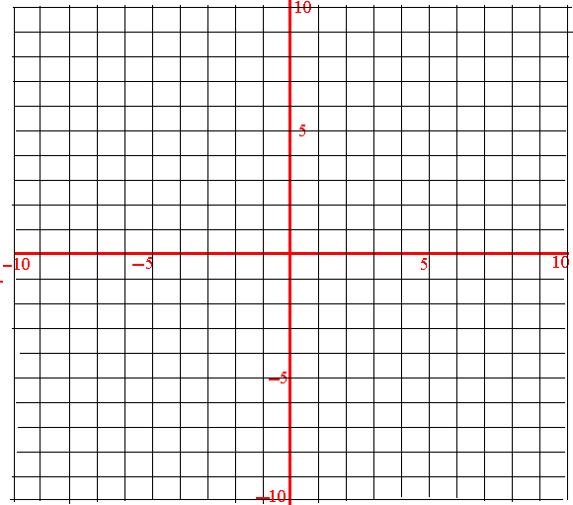
Graph the triangle with points A (1, 2), B(3, -4) and C (-2, 3). Then dilate the triangle with a scale factor of 2.

Slide 38
Graph the triangle with points A (1, 2), B(3, -4) and C (-2, 3). Then dilate the triangle with a scale factor of 1/2.

Slide 39
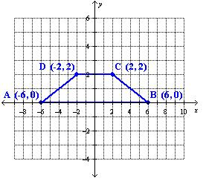
Use a dilation of 3/2 to find the image.

Slide 40
Translation
A translation moves every point of a figure the same distance in the same direction. (Think of sliding the figure right, left, up or down)
Coordinate notation is denoted by
(x,y)→(x + a, y + b) where a and b are numbers.
Vector form is denoted by <a, b> where a and b are horizontal and vertical movement.

Slide 41
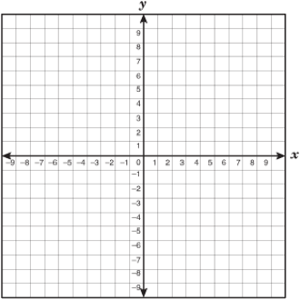
Translations
Quad ABCD has vertices A(-1, 2), B(-1, 5), C(4, 6), and D(4, 2).
Find the image of each vertex after the translation
(x, y)→(x + 3, y – 1).

Slide 42
Vectors
The vertices of triangle ABC are A(0, 3), B(2, 4), and C(1, 0). Translate triangle ABC using the
vector $\left\langle 5, −1\right\rangle$.

Slide 43
Translate the following
The vertices of triangle LMN are L(2, 2), M(5, 3), and N(9, 1). Translate the vertices by: (x, y)→(x – 5, y + 3)

Slide 44
Composition of Transformations

Slide 45
Composition of Transformations
When two or more transformations are combined, the result is a composition of transformations.
Simply execute both transformations in order.

Slide 46
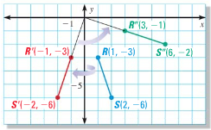
Composition of Transformations
The endpoints of RS are R(1, -3) and S(2, -6). Graph the image of RS after the composition.
Reflection in the y-axis
Rotation 90º about the origin

Slide 47
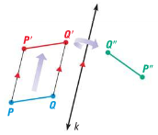
Glide Reflection
A glide reflection is composition of a translation and a reflection.
A translation maps P to P’
A reflection in a line k parallel to the direction of the translation maps P’ to P’’

Slide 48
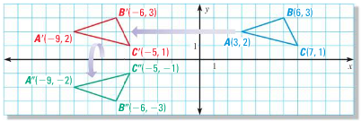
Glide Reflection
The vertices of Triangle ABC are A(3, 2), B(6, 3) and C(7, 1). Find the image of Triangle ABC after the glide reflection
(x, y)→(x – 12, y)
Reflection in the x-axis

Slide 49
Reflection in Parallel Lines Theorem
If lines k and m are parallel, then a reflection in line k followed by a reflection in line m is the same as a translation.

Slide 50
Example
Reflect across the y-axis and the line x = 4.
Q(-1, 2) and P(-2, 7).
What is the distance
between P and P”?

Slide 51
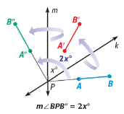
Reflection in Intersecting Lines Theorem
If lines k and m intersect at point P, then a reflection in k followed by a reflection in m is the same as a rotation about point P.
The angle of rotation is 2xº,
where xº is the measure of the
acute or right angle formed by
k and m.

Slide 52
Example
Reflect across the x-axis and the line y = -x.
Q(-2, -1) and P(-6, -2).
What is the angle of
rotation between
P and P”?

